Slide 1
Integration Testing Plan
The components are divided in 3 subsystems:
Application Server
Web Server
Client
Each subsystem can be tested separately.

Slide 2
Integration Strategy
Application Server → Bottom-up strategy
Stubs will be used only for external component not to be tested (e.g. Client, Email Server, etc.)
Web Server and Client → No precise integration strategy is needed
They strongly rely on remote services and network communication
They deal with the Graphical User Interface
They can be tested without complex integrations (stubs and drivers provided)

Slide 3
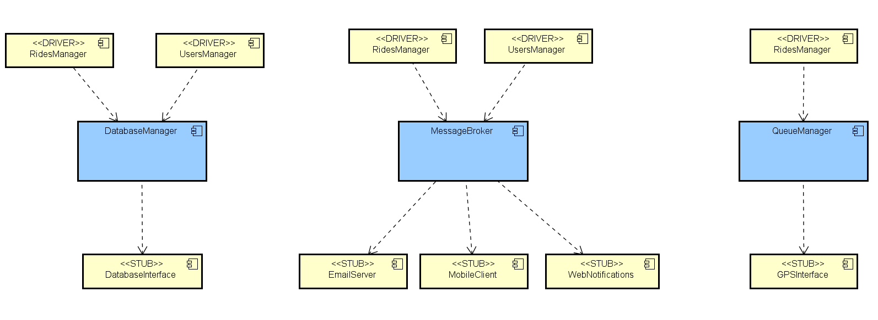
Application Server: Bottom-up testing
Step 1: DatabaseManager, QueueManager and MessageBroker are tested independently.
Next step: User Manager Integration

Slide 4
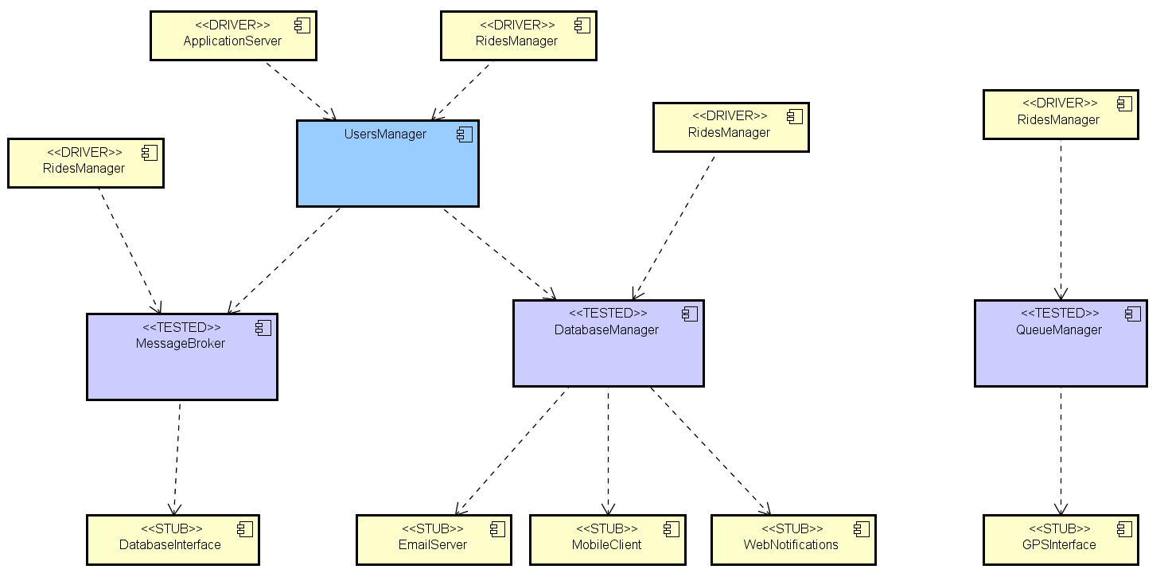
Step 2: User Manager.
Next step: Ride Manager Integration

Slide 5
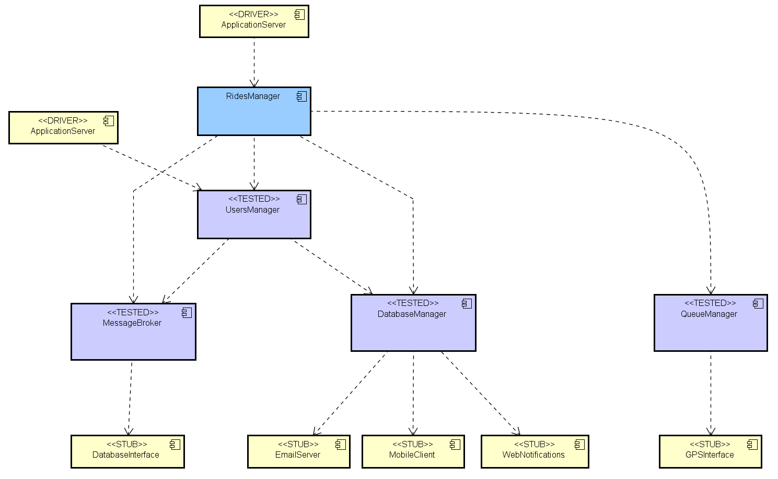
Next step:
Application Server Integration
Step 3: RidesManager.

Slide 6
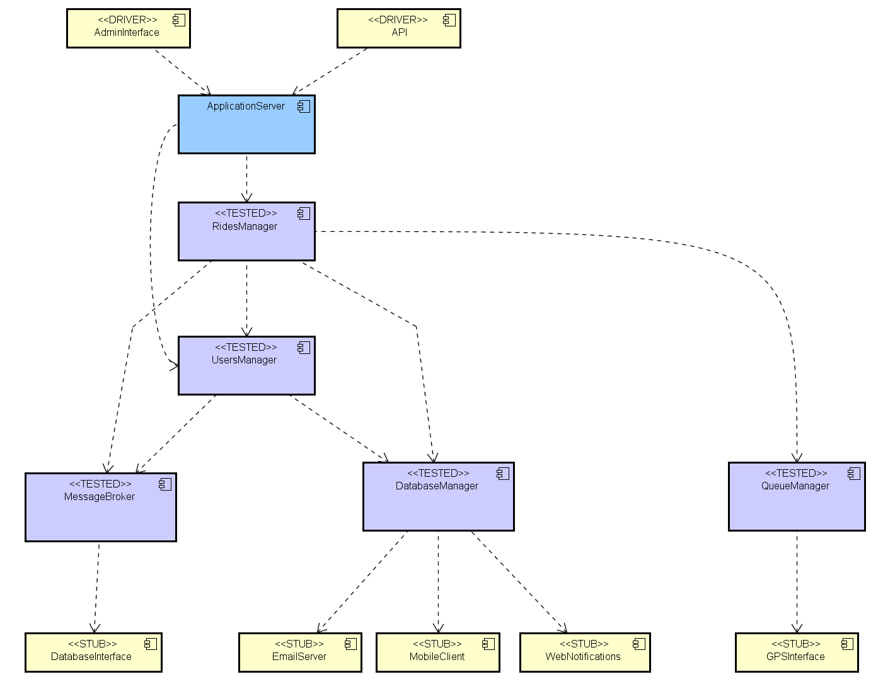
This was the last component!
Step 4: Application Server.

Slide 7
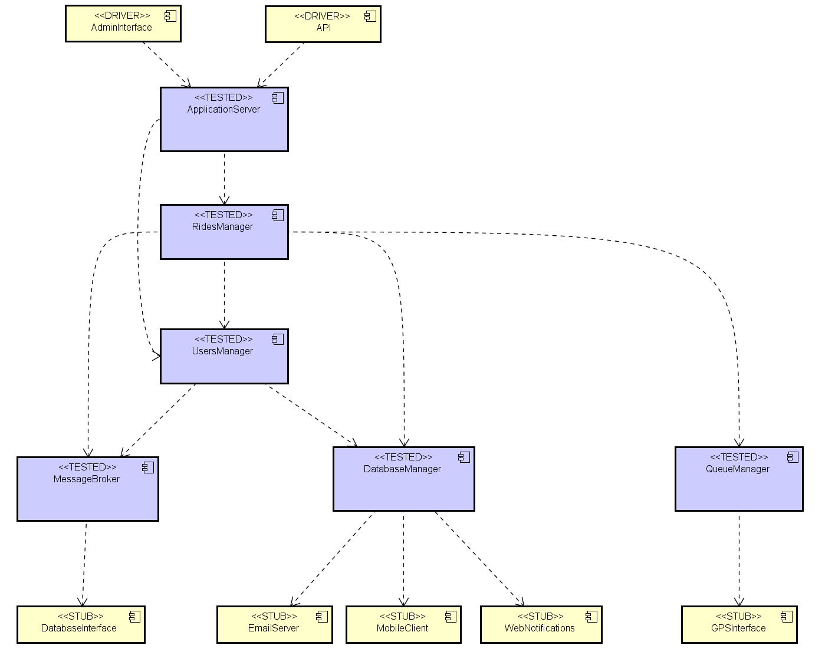
Final result: all components tested.

Slide 8
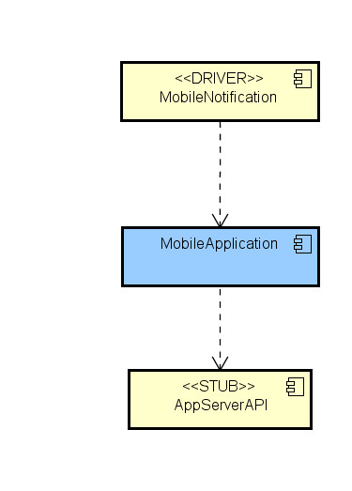
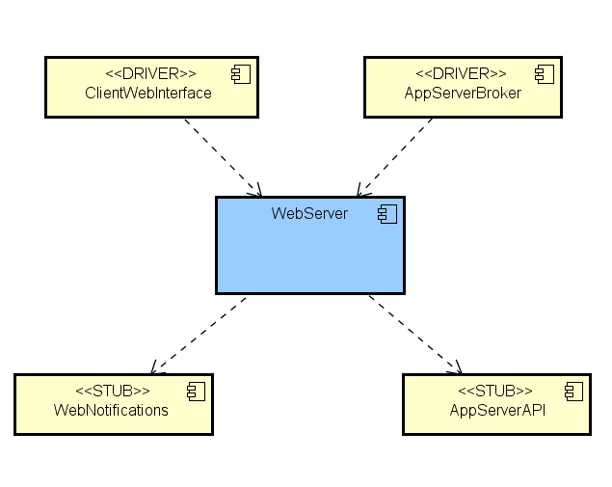
Web Server and Client
Web Server
Client
As said before, Client and Web Server can be tested alone, using only stubs and drivers.

